Slide 1
MoonX Assignment
-Shubham Koli

Slide 2
Problem Statement
Creating secure way of managing the exchange wallets.
Crypto exchanges maintain some of the customers’ crypto assets. Exchange needs do the transactions to reflect the exchange traded executions. But sometimes, they wallets are compromised and some tokens are syphoned out. Suggest and implement secure wallet management for Crypto exchange to protect its customer. 2FA, multi-sign, smart contract based protection etc are some of the ways.

Slide 3
Solution
Two Factor Authentication while login and doing transactions/trades.
I have used very innovative approach for managing the User private keys.

Slide 4
Specifications of Assignment
2FA Authentication
AES-256 Encryption.
2 Way Encryption
Innovative Private-Key Storing Architecture.
NodeJS, Express and MongoDB.

Slide 5

Procedure to start the Demo.
Download the code from the GitHub repository -https://github.com/Shubham-koli/MoonX-Test
Navigate to MoonX folder and type npm start
Scan the QR code with the Google Authenticator.
Demo will automatically initialize the Default User with username= MoonXUsername password= MoonXPassword Private Key= MoonXPrivateKey
Make sure you have MongoDB running on localhost:27017

Slide 6
Demo Continued
Open the Postman to generate the API request to backend. After Opening the Postman, Import the Postman folder path= MoonX/Tutorial/Postman
Now You need to Enter your google Authenticator Token In the Token Field of Post Body such as { "uid" : "MoonXUsername", "pwd" : "MoonXPassword", "Token" : “YOUR_TOKEN_HERE" }
If you input the 2FA code correctly you will get Private Key of user in return.

Slide 7
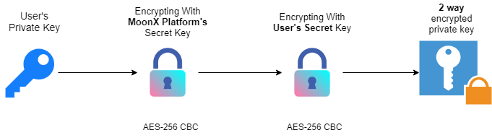
Magic Under The Hood!!!
Encryption
Encryption Algorithm used is AES-256 CBC
User’s Private Key is first Encrypted with MoonX Platform’s Secret key
Then it is again encrypted with User’s secret key. This key can be anything hash of Users SSN, KYC number or Anything that is unique to that user.
The output cryptographic text is impossible to decipher.
Most secure and efficient way.

Slide 8
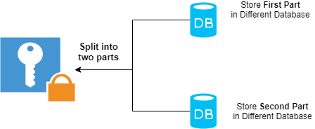
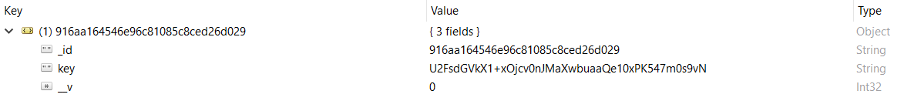
Magic Under The Hood!!!
Storing the Keys
The Output cryptographic text is split into two and stored in the two different databases
Even if one database gets compromised Hacker/Attacker, that database is worthless to him as it contains only half the contains.
Example:-

Slide 9
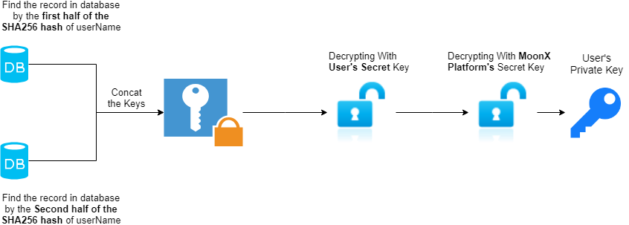
Magic Under The Hood!!!
Retrieving the keys
SHA256 Hash of User’s Username is used to find the Entry
Then Decrypt the cryptographic text with User’s Secret key.
Then Decrypt the cryptographic text with platforms Private key.
We will get the User’s Private key.

